Slide 1
Multiplayer Reach-Avoid Games
Mo Chen, UC Berkeley EECS
Zhengyuan Zhou, Stanford EE
Claire Tomlin, UC Berkeley EECS
Notes:
I’ll be talking about our work in multiplayer reach-avoid games. I’m from the EECS department of Berkeley, and this work is done with Zhengyuan Zhou from Stanford EE and Professor Claire Tomlin also from Berkeley EECS.

Slide 2
Outline
Formulation
Two player Hamilton Jacobi Isaacs (HJI) solution
Maximum Matching Multiplayer Approach
Generalizations and extensions
Notes:
I’ll be talking about the problem formulation, where I’ll be defining what a multiplayer reach-avoid game is.
Then, I’ll be presenting the HJI approach to solving a specific instance of the multiplayer game, involving only two players.
Afterwards, I’ll using the pairwise outcomes determined by the solution to the two player game as a building block and tie together the pairwise outcomes using the graph theoretic maximum matching to approximately solve the multiplayer game. I’ll show that our approximation maintains performance guarantees.
Finally, I’ll discuss generalizations and extensions of our methods

Slide 3
Outline
Formulation
Two player Hamilton Jacobi Isaacs (HJI) solution
Maximum Matching Multiplayer Approach
Generalizations and extensions

Slide 4




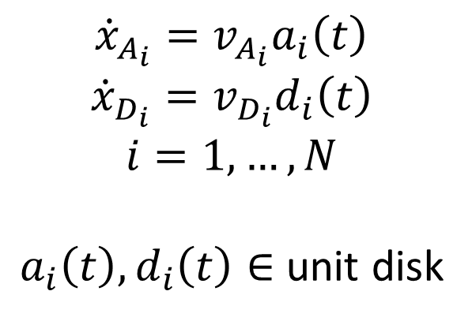




Formulation
Target
obstacle
defender
attacker
$$∂Ω$$
$$Ω_{free}$$
$$D_{1},…,D_{N}$$
$$Ω_{obs}$$
$$Ω$$
$$𝒯$$
$$A_{1},…,A_{N}$$
$$Ω_{obs}$$
$${\dot{x}}_{A_{i}}=v_{A_{i}}a_{i}\left(t\right)$$
$${\dot{x}}_{D_{i}}=v_{D_{i}}d_{i}\left(t\right)$$
$$i=1,…,N$$
$a_{i}\left(t\right),d_{i}\left(t\right)∈$ unit disk
Notes:
The multiplayer reach-avoid game is a differential game between two adversarial teams of N cooperative players playing on some compact domain possibly with obstacles.
The attacking team aims to send m attackers to some target set, while the defending team aims to prevent the attacking team from doing so by capturing or indefinitely delaying the attackers.
The players have simple dynamics: they can move in any direction at some maximum speed.

Slide 5
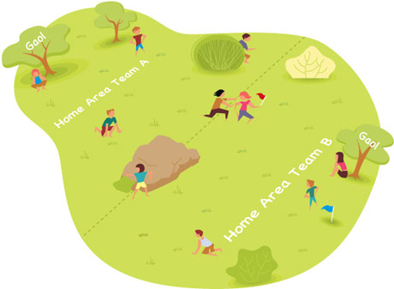
Why Multiplayer Reach-Avoid Games?
High dimensionality: Difficult to solve
Difficult to intuit
Humans sometimes play suboptimally even in a 1 vs. 1
Cooperation / Asymmetry
Applications in robotics and aircraft safety
http://playwithup.com/wp-content/uploads/2012/08/capture-the-flag-1.jpeg
Notes:
Multiplayer reach-avoid games are difficult to solve because of its high dimensionality. For example, if 10 players play on a 2D surface, their joint state space is 20 dimensions.
Despite the difficulty, it’s still important to find the optimal way to play, because even in a 1 vs 1 situation, humans intuition is suboptimal. This was demonstrated by work done previously in our lab, where two students played capture the flag against each other. One player had access to the calculated optimal control in real time, and the other player played based on intuition. The player who did not have the optimal control information lost the game even when he would have won if he played optimally.
With multiple players on each team, cooperation makes the game even more complex.
Applications of these games include safety in automated systems such as robots and aircrafts

Slide 6
Solving Differential Games
General treatment
Hamilton-Jacobi Isaacs (HJI) approach
Solves a partial differential equation (PDE) in joint state space [Mitchell, Bayen, Tomlin 2005] [Huang, Tomlin et al 2011]
Other approaches require specific assumptions
Attackers move toward target in straight lines
mixed-integer linear program [Earl, D’Andrea 2007]
Attackers use linear feedback control law
linear program [Chasparis, Shamma 2005]
Other approaches
Approximate dynamic programming [McGrew, Roy et al 2008]
Model predictive control [Sprinkle, Sastry et al 2004]
Notes:
The most general way to solve reach-avoid games is to use the Hamilton-Jacobi-Isaacs approach, in which a PDE in the joint state space of all players is solved.
There are other approaches with certain assumptions. For example, the game can be analyzed using a mixed-integer linear program if we assume that attackers move towards the target in straight lines, or a linear program if we assume that the attackers use a linear feedback control law.
Other approaches include using approximate dynamic programming, which lacks guarantees, or model predictive control, which requires knowledge of the cost function of the adversary.
Slides 1-6: 3:40
-----------------
ADP lacks guarantees?
MPC requires knowledge of cost function of adversary

Slide 7
Solving Differential Games
General treatment
Hamilton-Jacobi Isaacs (HJI) approach
Solves a partial differential equation (PDE) in joint state space [Mitchell, Bayen, Tomlin 2005] [Huang, Tomlin et al 2011]
Other approaches require specific assumptions
Attackers move toward target in straight lines
mixed-integer linear program [Earl, D’Andrea 2007]
Attackers use linear feedback control law
linear program [Chasparis, Shamma 2005]
Other approaches
Approximate dynamic programming [McGrew, Roy et al 2008]
Model predictive control [Sprinkle, Sastry et all 2004]
Notes:
We will focus on the HJI approach as it is applicable most generally.

Slide 8
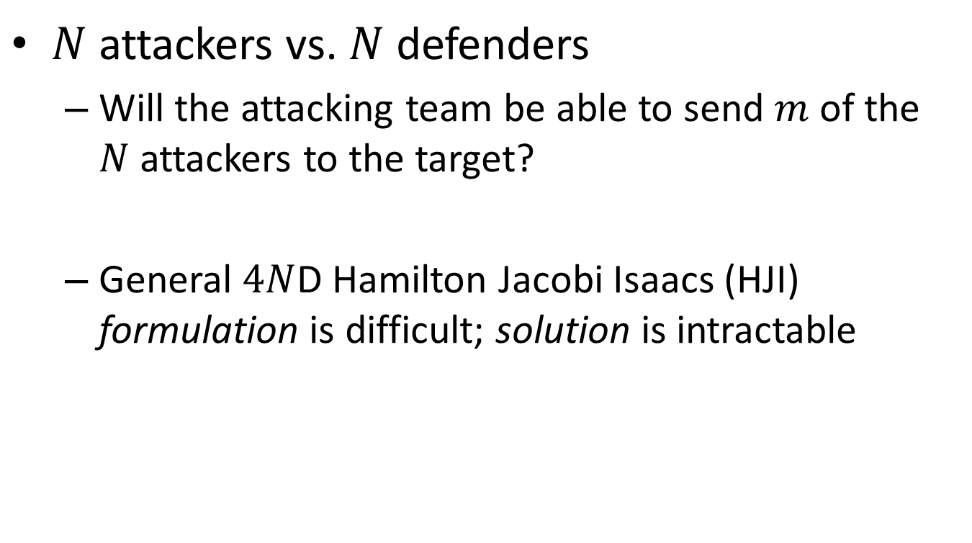
Multiplayer Reach-Avoid Game
$N$ attackers vs. $N$ defenders
Will the attacking team be able to send $m$ of the $N$ attackers to the target?
General $4N$D Hamilton Jacobi Isaacs (HJI) formulation is difficult; solution is intractable
Notes:
In our N vs. N game, we’d like to answer the question of whether m attackers will be able to reach the target.
We can answer this question by directly solving the corresponding HJI PDE, but this would not be numerically tractable for N>1. In a game with 2N players, the joint state space will be 4N dimensional, so we will not be able to grid up the state space to solve the PDE.

Slide 9
Outline
Formulation
Two player Hamilton Jacobi Isaacs (HJI) solution
Maximum Matching Multiplayer Approach
Generalizations and extensions
Notes:
I’ll be talking about the problem formulation, where I’ll be defining what a multiplayer reach-avoid game is.
Then, I’ll be presenting our proposed method for approximately solving the multiplayer game using maximum matching, assuming we have the pair-wise outcomes from a two player game.
Afterwards, I’ll describe how to determine the pair-wise outcomes using a Hamilton-Jacobi-Isaacs approach
Finally, I’ll discuss generalizations and extensions of our methods

Slide 10
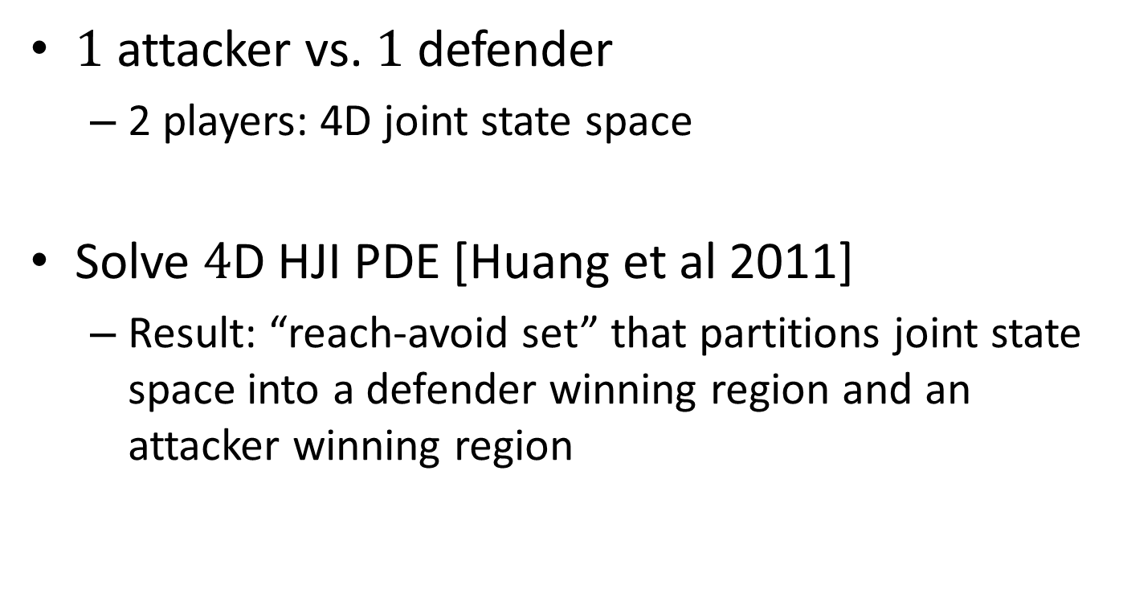
Two Player Game
$1$ attacker vs. $1$ defender
2 players: 4D joint state space
Solve $4$D HJI PDE [Huang et al 2011]
Result: “reach-avoid set” that partitions joint state space into a defender winning region and an attacker winning region
Notes:
For the two player game with each player playing on a two-dimensional surface, the joint state space is 4D. In this case, we can directly solve the corresponding 4D HJI PDE

Slide 11
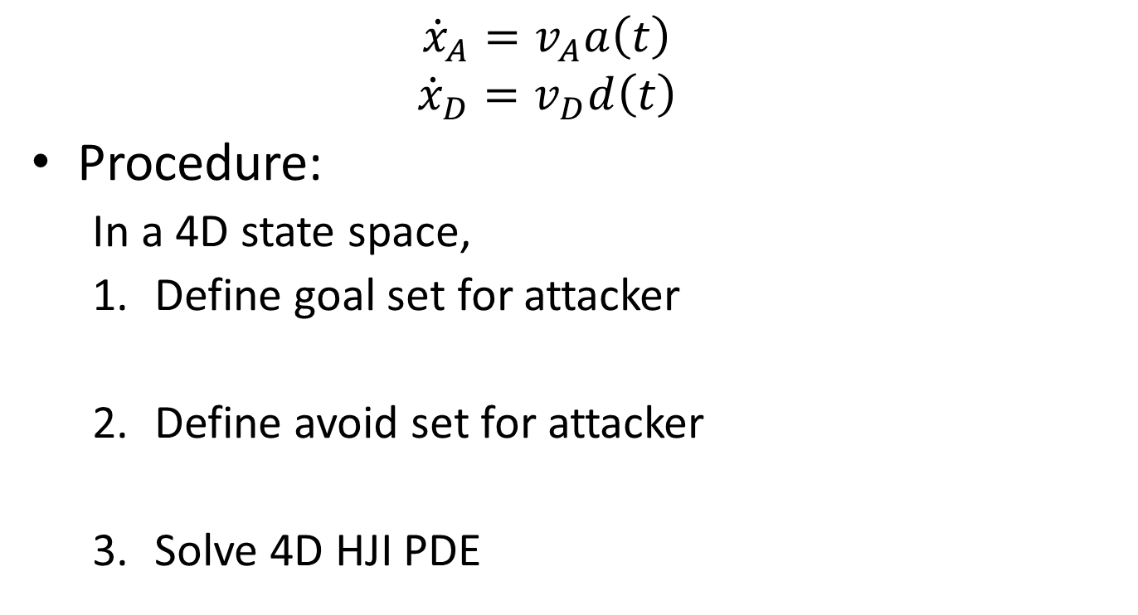
4D HJI Solution
$${\dot{x}}_{A}=v_{A}a\left(t\right)$$
$${\dot{x}}_{D}=v_{D}d\left(t\right)$$
Procedure:
In a 4D state space,
Define goal set for attacker
Define avoid set for attacker
Solve 4D HJI PDE
Notes:
Given the player dynamics, we will use the following procedure to determine pair-wise outcomes. First, in the 4D state space, define the goal set for the attacker. Then, define the avoid set for the attacker. Finally, we will solve the resulting 4D HJI PDE.

Slide 12
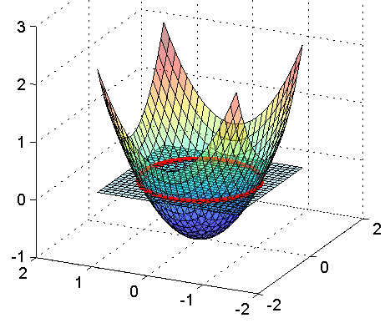
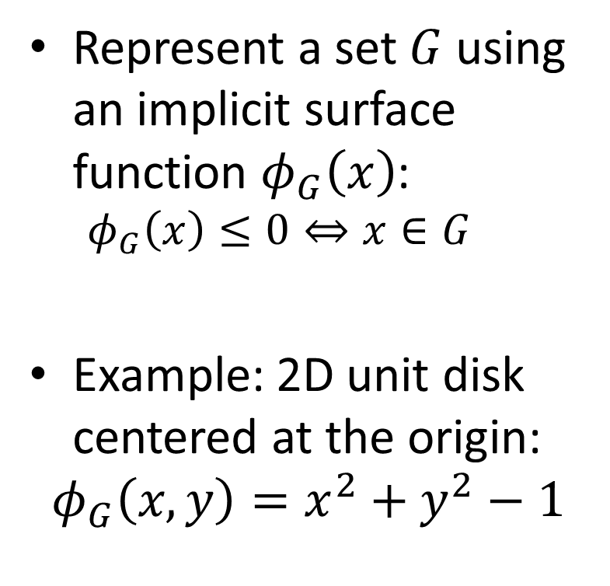
Defining sets
Represent a set $G$ using an implicit surface function $φ_{G}\left(x\right)$:
$$φ_{G}\left(x\right)≤0⇔x∈G$$
Example: 2D unit disk centered at the origin:
$$φ_{G}\left(x,y\right)=x^{2}+y^{2}−1$$
Notes:
In the HIJ approach, sets are represented by the sub-0 level set of some function. For example, a 2D unit disk centered at the origin would be represented by phi_G of x y equals x squared + y squared – 1. The part of phi that is less than or equal to 0 would represent the unit disk

Slide 13

Defining sets
Goal set: $φ_{R}$
Attacker wins if she reaches the target or if the defender gets stuck at an obstacle
$$R=\left\{x∈ℝ^{4}:x_{A}∈𝒯\right\}∪\left\{x∈ℝ^{4}:x_{D}∈Ω_{obs}\right\}$$
Avoid set: $φ_{A}$
Attacker loses if she gets captured or gets stuck at an obstacle
$$A=\left\{x∈ℝ^{4}:{\left\|x_{A}−x_{D}\right\|}_{2}≤R_{C}\right\}∪\left\{x∈ℝ^{4}:x_{A}∈Ω_{obs}\right\}$$
Notes:
The goal set represents the attacker’s winning conditions. The attacker wins if she reaches the target or if the defender gets stuck at an obstacle.

Slide 14
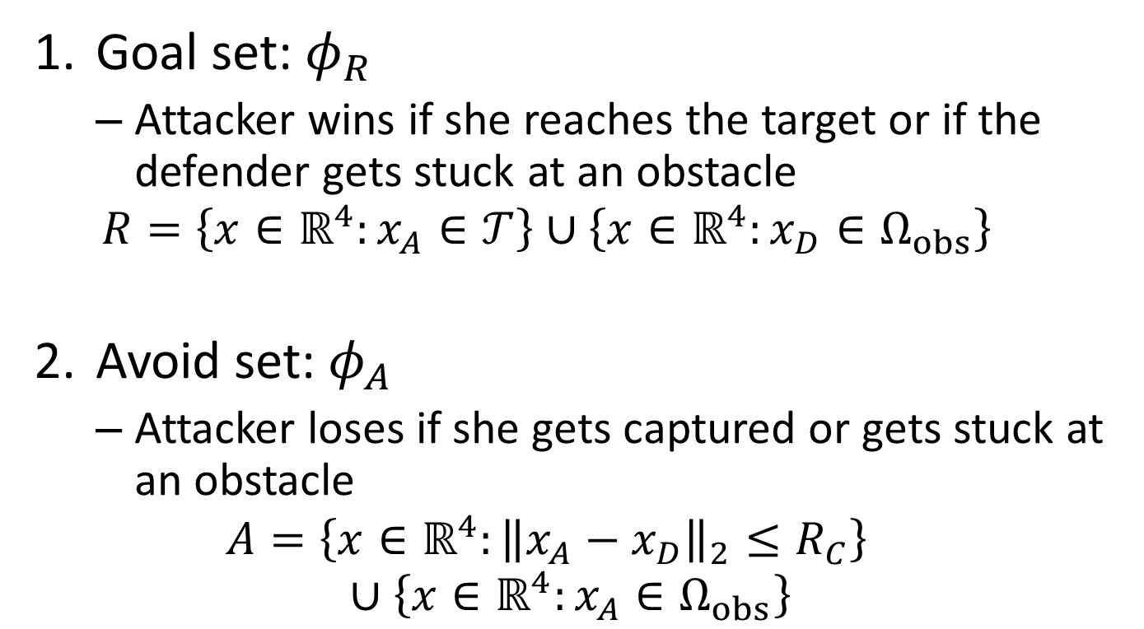
Defining sets
Goal set: $φ_{R}$
Attacker wins if she reaches the target or if the defender gets stuck at an obstacle
$$R=\left\{x∈ℝ^{4}:x_{A}∈𝒯\right\}∪\left\{x∈ℝ^{4}:x_{D}∈Ω_{obs}\right\}$$
Avoid set: $φ_{A}$
Attacker loses if she gets captured or gets stuck at an obstacle
$$A=\left\{x∈ℝ^{4}:{\left\|x_{A}−x_{D}\right\|}_{2}≤R_{C}\right\}∪\left\{x∈ℝ^{4}:x_{A}∈Ω_{obs}\right\}$$
Notes:
The avoid set represents the attacker’s losing conditions. The attacker loses if she gets captured or gets stuck at an obstacle

Slide 15

Solve HJI PDE
$Φ:ℝ^{n}×\left[−T,0\right]→ℝ$ is the solution to
$$\frac{∂Φ}{∂t}+min\left[0,H\left(x,∇Φ \right)\right]=0,Φ\left(x,0\right)=φ_{R}\left(x\right)$$
subject to
$$Φ\left(x,t\right)≥−φ_{A}\left(x\right)$$
where the Hamiltonian is given by
$$H\left(x,p\right)=\min_{a}{\max_{d}{p^{T}f\left(x,a,d\right)}}$$
In our case with decoupled dynamics, order of min and max doesn’t matter (Isaac’s condition holds)
Notes:
Once we have defined the target set and avoid set, we can solve the HJI PDE. The target set comes in as an initial condition, and the avoid set is in the constraint

Slide 16
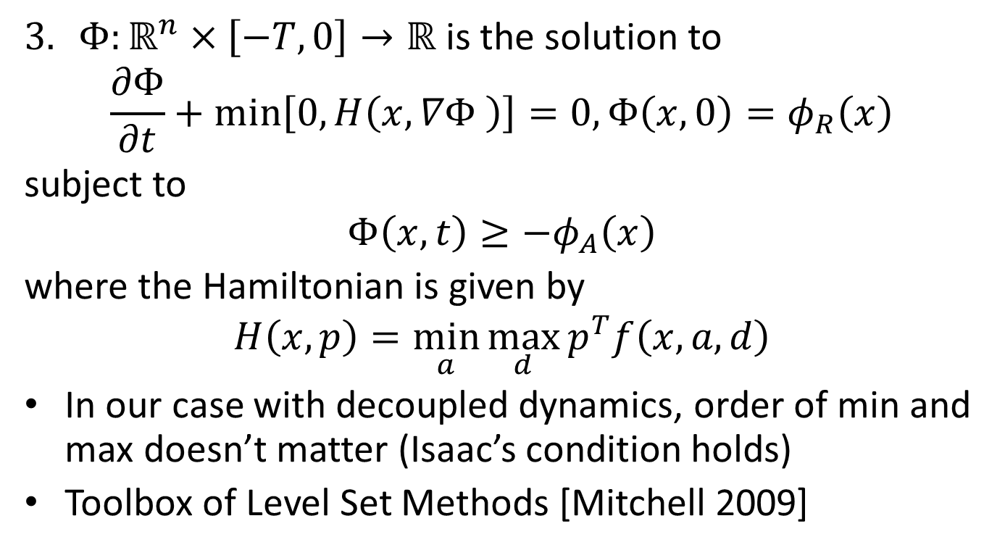
Solve HJI PDE
$Φ:ℝ^{n}×\left[−T,0\right]→ℝ$ is the solution to
$$\frac{∂Φ}{∂t}+min\left[0,H\left(x,∇Φ \right)\right]=0,Φ\left(x,0\right)=φ_{R}\left(x\right)$$
subject to
$$Φ\left(x,t\right)≥−φ_{A}\left(x\right)$$
where the Hamiltonian is given by
$$H\left(x,p\right)=\min_{a}{\max_{d}{p^{T}f\left(x,a,d\right)}}$$
In our case with decoupled dynamics, order of min and max doesn’t matter (Isaac’s condition holds)
Toolbox of Level Set Methods [Mitchell 2009]
Notes:
The Hamiltonian is given by this min max expression which we will derive next. Since we have decoupled dynamics, the order of min and max doesn’t matter.

Slide 17
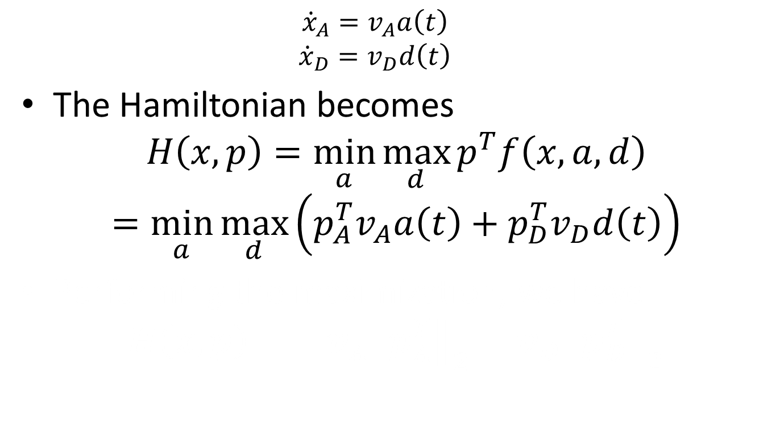
The Hamiltonian
$${\dot{x}}_{A}=v_{A}a\left(t\right)$$
$${\dot{x}}_{D}=v_{D}d\left(t\right)$$
The Hamiltonian becomes
$$H\left(x,p\right)=\min_{a}{\max_{d}{p^{T}f\left(x,a,d\right)}}$$
$$=\min_{a}{\max_{d}\left(p_{A}^{T}v_{A}a\left(t\right)+p_{D}^{T}v_{D}d\left(t\right)\right)}$$
Performing the maximization, we have
$$H\left(x,p\right)=−v_{A}{\left\|p_{A}^{T}\right\|}_{2}+v_{D}{\left\|p_{D}^{T}\right\|}_{2}$$
Notes:
Given our dynamics, we have the following Hamiltonian. pA represents the components of p, the costate, corresponding to the attacker’s control and pD represents the components of p that corresponds to the defender’s control.

Slide 18
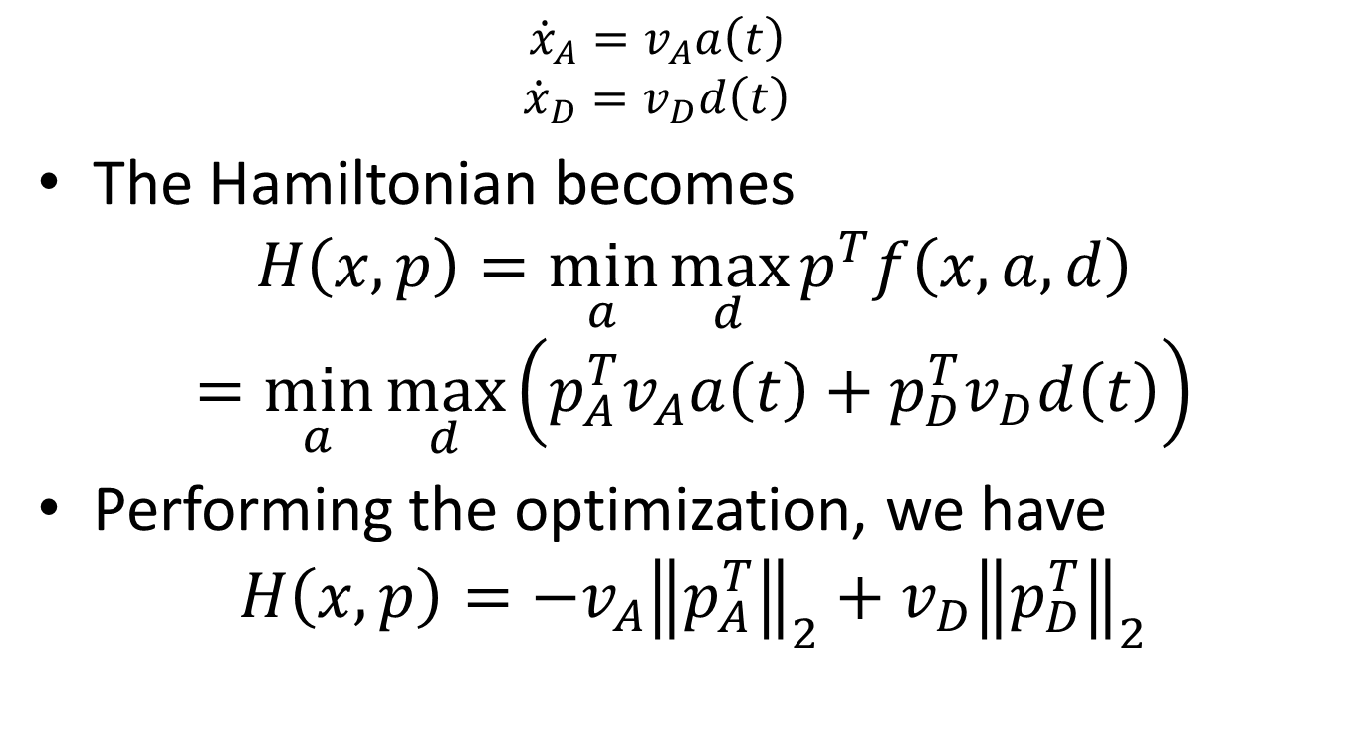

The Hamiltonian
$${\dot{x}}_{A}=v_{A}a\left(t\right)$$
$${\dot{x}}_{D}=v_{D}d\left(t\right)$$
The Hamiltonian becomes
$$H\left(x,p\right)=\min_{a}{\max_{d}{p^{T}f\left(x,a,d\right)}}$$
$$=\min_{a}{\max_{d}\left(p_{A}^{T}v_{A}a\left(t\right)+p_{D}^{T}v_{D}d\left(t\right)\right)}$$
Performing the optimization, we have
$$H\left(x,p\right)=−v_{A}{\left\|p_{A}^{T}\right\|}_{2}+v_{D}{\left\|p_{D}^{T}\right\|}_{2}$$
$p_{D}$ or $p_{A}$
Notes:
Performing the optimization, we have the following hamiltonian

Slide 19
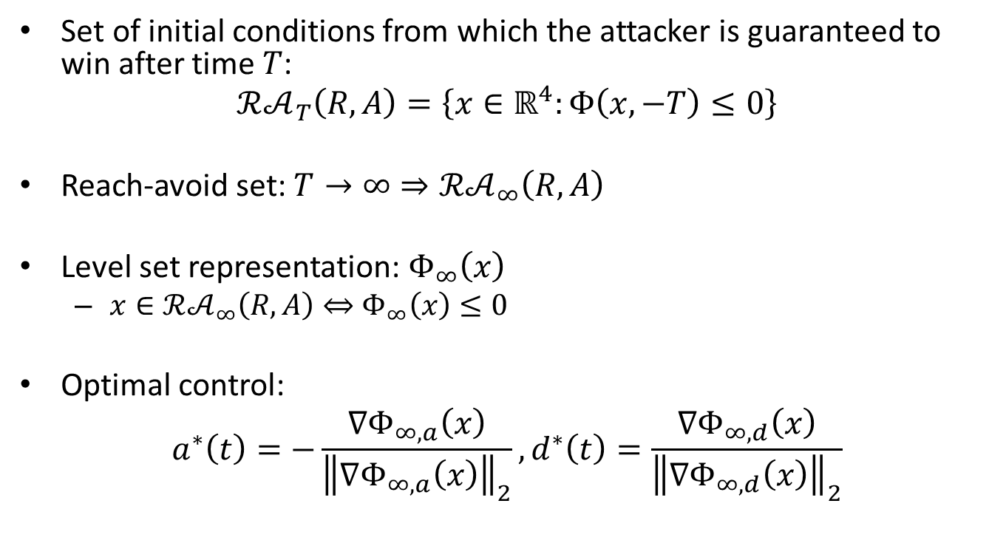

Solution to the 4D HJI PDE
Set of initial conditions from which the attacker is guaranteed to win after time $T$:
$$ℛ𝒜_{T}\left(R,A\right)=\left\{x∈ℝ^{4}:Φ\left(x,−T\right)≤0\right\}$$
Reach-avoid set: $T→∞⇒ℛ𝒜_{∞}\left(R,A\right)$
Level set representation: $Φ_{∞}\left(x\right)$
$x∈ℛ𝒜_{∞}\left(R,A\right)⇔$ $Φ_{∞}\left(x\right)≤0$
Optimal control:
$$a^{∗}\left(t\right)=−\frac{∇Φ_{∞,a}\left(x\right)}{{\left\|∇Φ_{∞,a}\left(x\right)\right\|}_{2}},d^{∗}\left(t\right)=\frac{∇Φ_{∞,d}\left(x\right)}{{\left\|∇Φ_{∞,d}\left(x\right)\right\|}_{2}}$$
$∇Φ_{∞,a}$or $∇Φ_{∞,d}$
Notes:
Given some joint state x, we can determine the winner of the game simply by evaluating Phi_infinity to see whether the value is less than or equal to 0

Slide 20
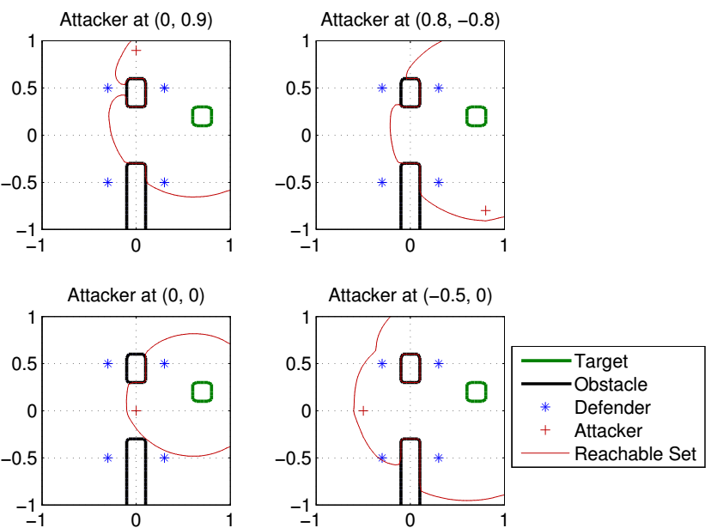
Results: reach-avoid slices
Notes:
These plots show the results. The domain is square, the block rectangles are the obstacles, and the green square is the target set. The blue stars are defender positions and the red crosses are attacker positions.
To visualize the 4D reach-avoid set, we take 2D slices sliced at the position of various players. These plots show the reach-avoid set sliced at the attacker positions. In the left top plot, for example, the attacker loses against defenders that are inside the red boundary, these two, and wins against the other two defenders. In the next subplot, the attacker wins and loses against the same defenders. Similarly you can see the pair-wise outcomes for the other two attackers

Slide 21
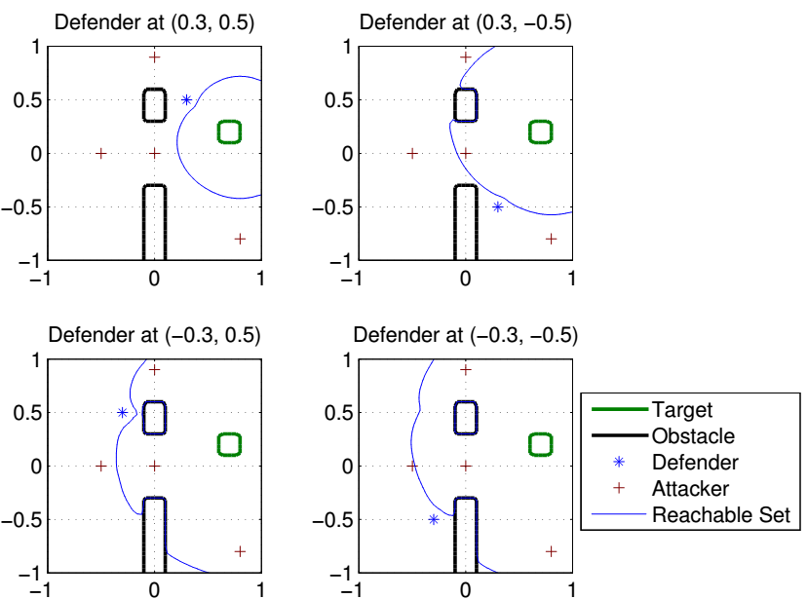
Results: reach-avoid slices
Notes:
Here we slice the reach-avoid set at defender positions. In this plot, for example, the defender loses against these 3 attackers inside the blue boundary, and wins against the other attacker. The results shown here are consistent with the results in the previous slide.

Slide 22
Outline
Formulation
Two player Hamilton Jacobi Isaacs (HJI) solution
Maximum Matching Multiplayer Approach
Generalizations and extensions
Notes:
I’ll be talking about the problem formulation, where I’ll be defining what a multiplayer reach-avoid game is.
Then, I’ll be presenting our proposed method for approximately solving the multiplayer game using maximum matching, assuming we have the pair-wise outcomes from a two player game.
Afterwards, I’ll describe how to determine the pair-wise outcomes using a Hamilton-Jacobi-Isaacs approach
Finally, I’ll discuss generalizations and extensions of our methods

Slide 23
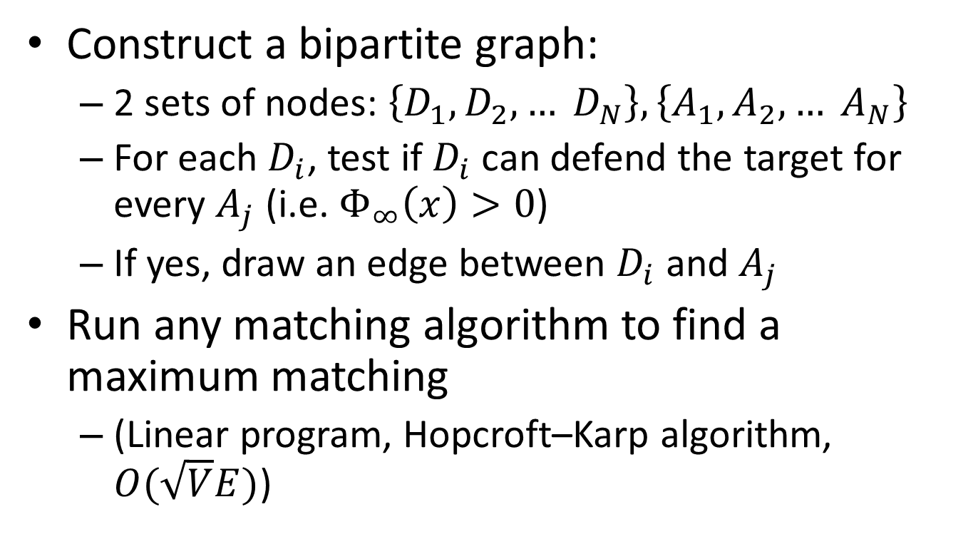
From Two Player to Multiplayer
Construct a bipartite graph:
2 sets of nodes: $\left\{D_{1}, D_{2}, … D_{N}\right\},\left\{A_{1},A_{2},… A_{N}\right\}$
For each $D_{i}$, test if $D_{i}$ can defend the target for every $A_{j}$ (i.e. $Φ_{∞}\left(x\right)>0$)
If yes, draw an edge between $D_{i}$ and $A_{j}$
Run any matching algorithm to find a maximum matching
(Linear program, Hopcroft–Karp algorithm, $O(\sqrt{V}E)$)
Notes:
To tie together the pair-wise outcomes, we construct a bipartite graph as follows: we let the players on each team represent two sets of nodes, D1 to Dn and A1 to An. For each defender, test whether defender I can defend the target for every attacker j. If so, draw an edge between Di and Aj.
Once we have the graph, we can run any matching algorithm to find a maximum matching. The size of the maximum matching guarantees that the defenders can prevent all the attackers that are matched to a defender from reaching the target.

Slide 24



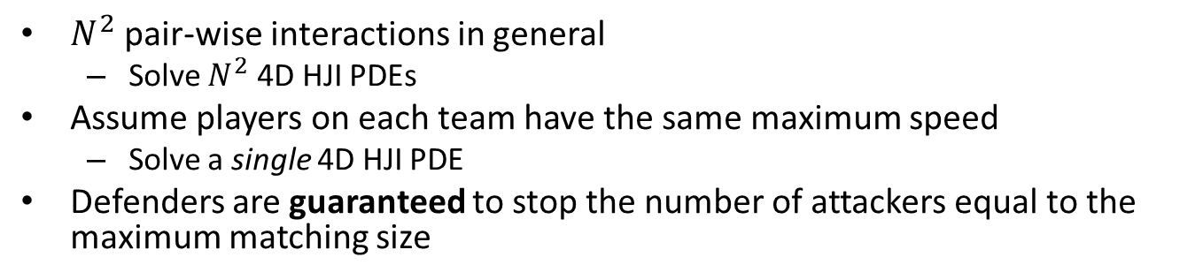


















Two-player game to multiplayer game
$N^{2}$ pair-wise interactions in general
Solve $N^{2}$ 4D HJI PDEs
Assume players on each team have the same maximum speed
Solve a single 4D HJI PDE
Defenders are guaranteed to stop the number of attackers equal to the maximum matching size
$$A_{1}$$
4D HJI PDE solution
$$Φ_{∞}\left(x\right)$$
$$D_{1}$$
$$A_{1}$$
$$D_{1}$$
$$d_{2}^{∗}(t)$$
$$A_{2}$$
$$D_{2}$$
$$A_{2}$$
Maximum matching
$$D_{2}$$
$$d_{1}^{∗}(t)$$
$$A_{3}$$
$$d_{3}^{∗}(t)$$
$$D_{3}$$
$$A_{3}$$
$$D_{3}$$
$$d_{4}^{∗}(t)$$
$$A_{4}$$
$$D_{4}$$
$$A_{4}$$
$$D_{4}$$
Notes:
This diagram summarizes the process of tying together pair-wise outcomes. The pair-wise outcomes can be determined by solving a 4D HJI PDE corresponding to the two-player game between an attacker and a defender. We use the pair-wise outcomes to create a bipartite graph shown here on the left.
Then, we can compute the maximum matching to determine the optimal way for the defenders to pair up against the attackers. Having established the pairings, each defender can then use the optimal control d^* which can be obtained from the solution to the HJI PDE.

Slide 25
Results: reach-avoid slices
Notes:
Here we slice the reach-avoid set at defender positions. In this plot, for example, the defender loses against these 3 attackers inside the blue boundary, and wins against the other attacker. The results shown here are consistent with the results in the previous slide.

Slide 26
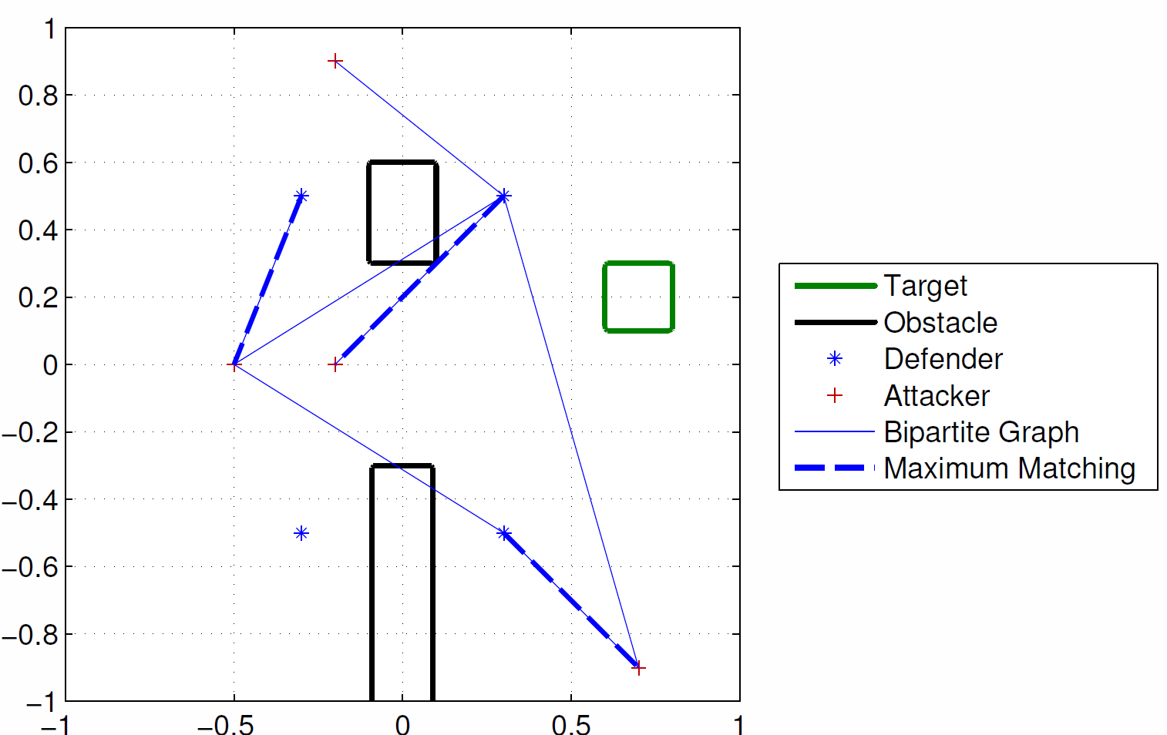
Results: Maximum Matching
Notes:
Given the pair-wise outcomes, we can now construct a bipartite graph, which is shown in the thin blue lines. For example, the defender here (top right) wins against all 4 attackers in 1 vs. 1. The defender here (top left) wins against this attacker.
The thick dotted blue lines show the resulting maximum matching. Here the maximum matching is of size 3, which means that at most one attacker will be able to reach the target.

Slide 27
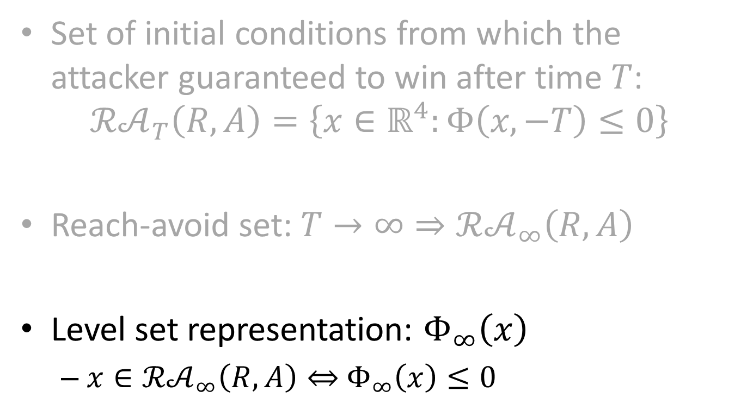
Solution to the 4D HJI PDE
Set of initial conditions from which the attacker guaranteed to win after time $T$:
$$ℛ𝒜_{T}\left(R,A\right)=\left\{x∈ℝ^{4}:Φ\left(x,−T\right)≤0\right\}$$
Reach-avoid set: $T→∞⇒ℛ𝒜_{∞}\left(R,A\right)$
Level set representation: $Φ_{∞}\left(x\right)$
$x∈ℛ𝒜_{∞}\left(R,A\right)⇔$ $Φ_{∞}\left(x\right)≤0$
Notes:
Recall that the solution to the 4D HJI PDE characterizes the pair-wise outcomes for any given joint initial condition; we just have to plug in the joint state into phi infinity.

Slide 28
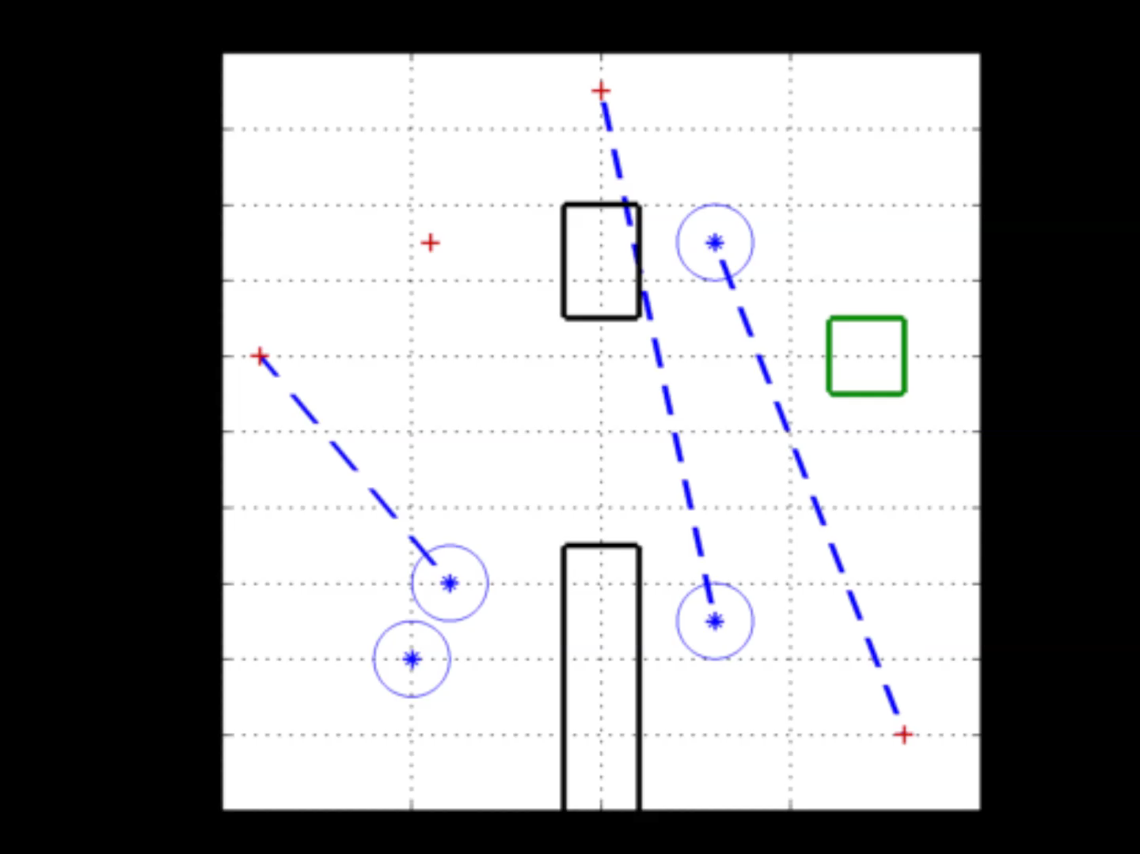
Real Time Maximum Matching Update
Notes:
So the maximum matching can be computed in real time as the players play out the game. Often, the size of the maximum matching will increase as the players play out the game, as shown in this simulation.
The blue stars are defenders, the red crosses are attackers, the black rectangles are obstacles and the green square is the target set.

Slide 29
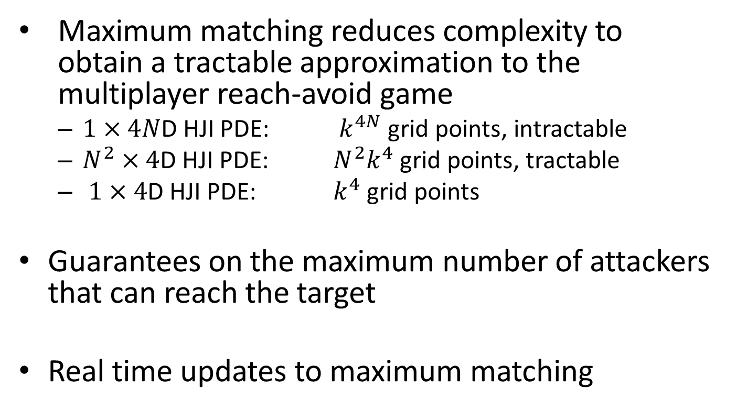
Conclusion
Maximum matching reduces complexity to obtain a tractable approximation to the multiplayer reach-avoid game
$1×4$𝑁D HJI PDE: $k^{4N}$ grid points, intractable
$N^{2}×4$D HJI PDE: $N^{2}k^{4}$ grid points, tractable
$1×4$D HJI PDE: $k^{4}$ grid points
Guarantees on the maximum number of attackers that can reach the target
Real time updates to maximum matching

Slide 30
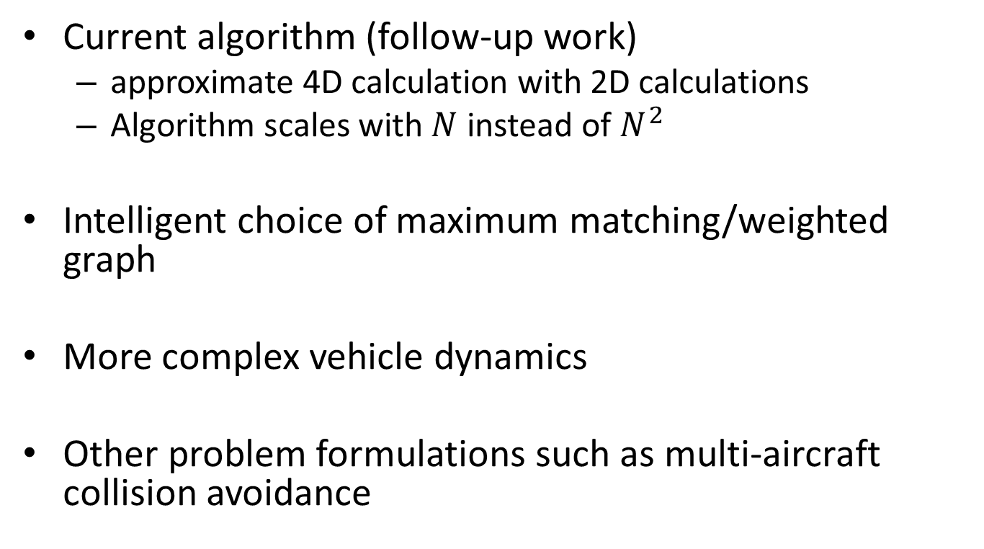
Future Work
Current algorithm (follow-up work)
approximate 4D calculation with 2D calculations
Algorithm scales with $N$ instead of $N^{2}$
Intelligent choice of maximum matching/weighted graph
More complex vehicle dynamics
Other problem formulations such as multi-aircraft collision avoidance

Slide 31
Thank You!
Some references
I. Mitchell, A. Bayen, and C. Tomlin, “A time-dependent Hamilton-Jacobi formulation of reachable sets for continuous dynamic games,” IEEE Transactions on Automatic Control, vol. 50, no. 7, pp. 947–957, July 2005.
H. Huang, J. Ding, W. Zhang, and C. Tomlin, “A differential game approach to planning in adversarial scenarios: A case study on capture-the-flag,” in Robotics and Automation (ICRA), 2011 IEEE International Conference on, 2011, pp. 1451–1456.
M. Earl and R. D’Andrea, “A decomposition approach to multi-vehicle cooperative control,” Robotics and Autonomous systems, vol. 55, no. 4, pp. 276–291, 2007.
G. Chasparis and J. Shamma, “Linear-programming-based multivehicle path planning with adversaries,” American Control Conference, 2005. Proceedings of the 2005, pp. 1072–1077, 2005.
J. McGrew, J. How, L. Bush, B. Williams, and N. Roy, “Air combat strategy using approximate dynamic programming,” AIAA Guidance, Navigation, and Control Conference, Aug 2008.
J. Sprinkle, J. Eklund, H. Kim, and S. Sastry, “Encoding aerial pursuit/evasion games with fixed wing aircraft into a nonlinear model predictive tracking controller,” Decision and Control, 43rd IEEE Conference on, 2004.
I. Mitchell, A Toolbox of Level Set Methods, 2009, http://people.cs.ubc.ca/mitchell/ToolboxLS/index.html.

